Slide 1
Understanding RAID Levels: RAID 0, 1, 5, and 10
By: Rosemarie Kpaka

Slide 2
Introduction to RAID
RAID (Redundant Array of Independent Disks) is a data storage technology that combines multiple physical drives to enhance performance, reliability, or both.
RAID can protect data from hardware failures and increase read/write speeds based on the RAID level chosen.
Today, we'll cover RAID Levels 0, 1, 5, and 10.

Slide 3
What Are RAID Levels?
Each RAID level has different performance and redundancy characteristics.
Factors to consider: data protection, read/write speed, storage efficiency.
We'll explore four commonly used levels in detail."

Slide 4
RAID 0 Overview
RAID 0 (Striping): Focuses on performance by spreading data across multiple drives.
Does not offer redundancy; if one drive fails, all data is lost.
Increases read/write speeds, making it ideal for tasks requiring fast access.

Slide 5
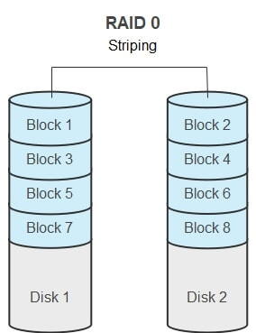
RAID 0 Overview
Data is divided into blocks and written across drives, enhancing speed.
In this example, data is split across two drives in a striped configuration.

Slide 6
RAID 1 Overview
RAID 1 (Mirroring): Provides redundancy by duplicating data across two drives.
If one drive fails, the second drive maintains an identical copy.
Ideal for applications where data availability is critical.

Slide 7
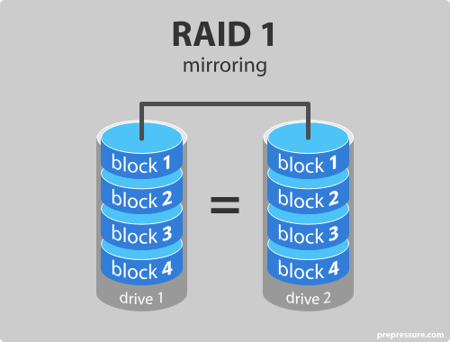
RAID 1 Overview
Data is written to both drives simultaneously, creating a mirror image.

Slide 8
RAID 5 Overview
RAID 5 (Striping with Parity): Balances performance and redundancy using three or more drives.
Distributes data and parity information across all drives.
If one drive fails, data can be rebuilt from parity.

Slide 9
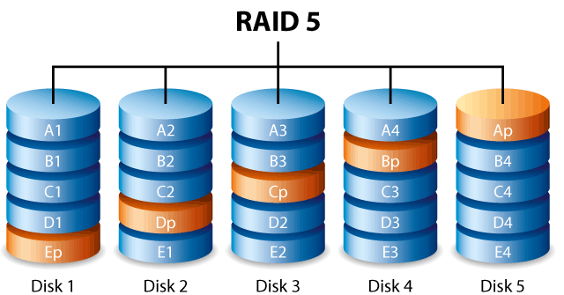
RAID 5 Overview
Data and parity are spread across all drives, enhancing fault tolerance.

Slide 10
RAID 10 Overview
RAID 10 (Combination of RAID 1 and RAID 0): Uses mirroring and striping for redundancy and performance.
Requires at least four drives, where data is striped across mirrored pairs.
Offers high performance with added fault tolerance.

Slide 11
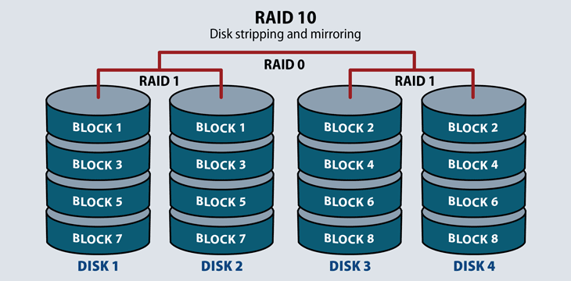
RAID 10 Overview
Data is mirrored and striped across multiple drives, ensuring speed and data protection.

Slide 12
Comparing RAID Levels
RAID Level | Redundancy | Read/Write Performance | Drive Requirement | Fault Tolerance
RAID 0 | None (No redundancy) | High (Striping for speed) | Minimum 2 drives | No fault tolerance (data loss if one drive fails)
RAID 1 | High (Mirroring) | Moderate (Mirroring limits write speed) | Minimum 2 drives | Fault tolerant (one drive can fail)
RAID 5 | Moderate (Parity) | Good (Striping with parity) | Minimum 3 drives | Fault tolerant (one drive can fail, data is rebuilt from parity)
RAID 10 | High (Mirrored Stripes) | High (Combines RAID 0 and RAID 1) | Minimum 4 drives | Fault tolerant (one drive in each mirrored pair can fail)
Choosing a RAID level depends on your priorities: speed, storage efficiency, or data security. RAID 0 is best for speed, RAID 1 for data protection, RAID 5 for a balance of both, and RAID 10 for high performance with redundancy.

Slide 13
Best Practices for Choosing a RAID Level
Considerations when choosing RAID levels:
1. Data criticality: RAID 1 or 10 if redundancy is a priority.
2. Performance needs: RAID 0 or 10 for applications needing fast read/write speeds.
3. Budget constraints: Higher RAID levels require more drives, impacting cost.

Slide 14
Conclusion
RAID offers various configurations to balance performance, storage, and redundancy.
Selecting the right RAID level depends on your specific storage needs.
Each RAID level has unique strengths and limitations, so evaluate based on your data requirements.

Slide 15
Thank You!
By: Rosemarie Kpaka

